Slide 1


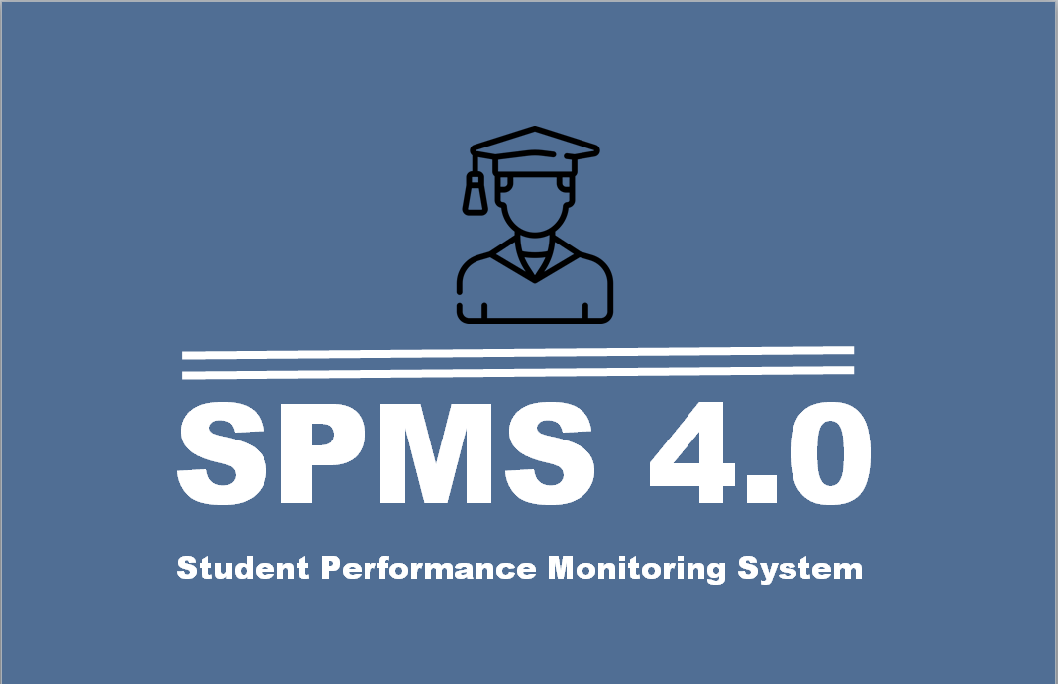
Group-17 : error 404
Presentation topic : Student performance monitoring system
Presented by : Abu sayed
Soumik Alam
Khademul islam
Al Rawnak Shafin
Mahabuba Akter Thithi
Rasel hossain
27.4.2023

Slide 2
Introduction:
In order to manage and track students' academic progress, educational institutions must use a student performance monitoring system. The system makes use of a database management system (DBMS) to gather, store, and analyze many sorts of data about student performance, including grades, attendance, and disciplinary records. With the use of this data, teachers are better equipped to support specific kids, spot weaknesses in their lesson plans and instructional strategies, and make sure that all students are meeting the necessary academic standards. Implementing a system to track student achievement can raise the standard of instruction offered by a school and eventually assist students in achieving their academic objectives. Organizing and managing the necessary data in this situation requires the use of DBMS.

Slide 3
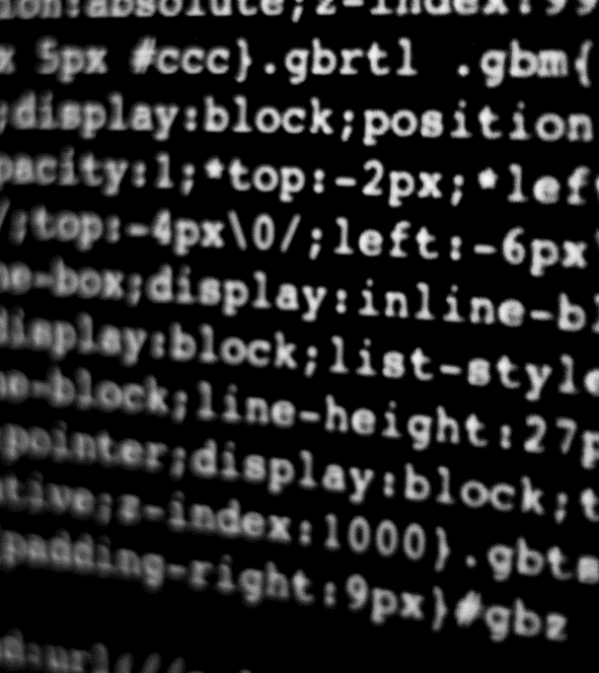
Let’s Dive Into the web-based student performance monitoring system

Slide 4
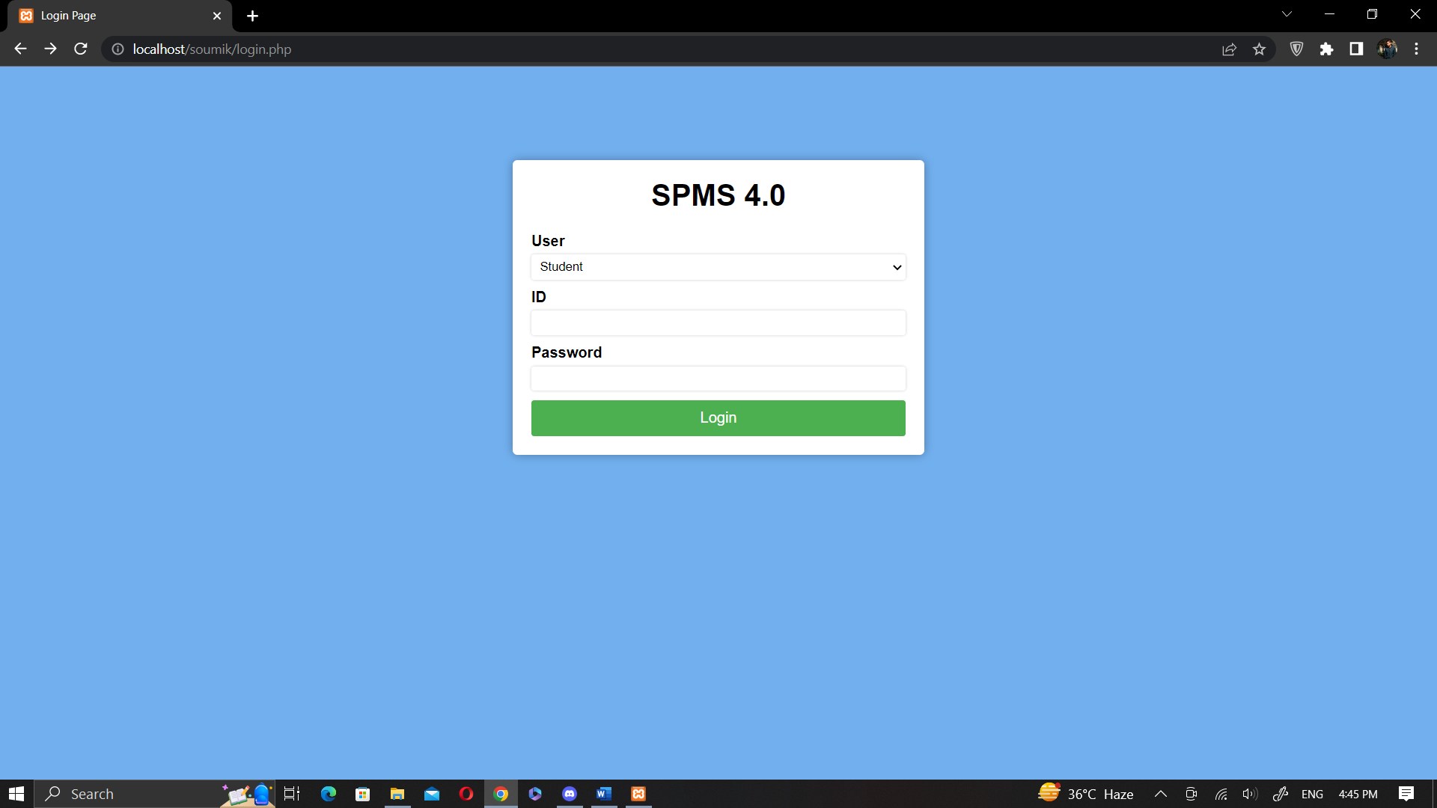
login page of student performance monitoring system:

Slide 5
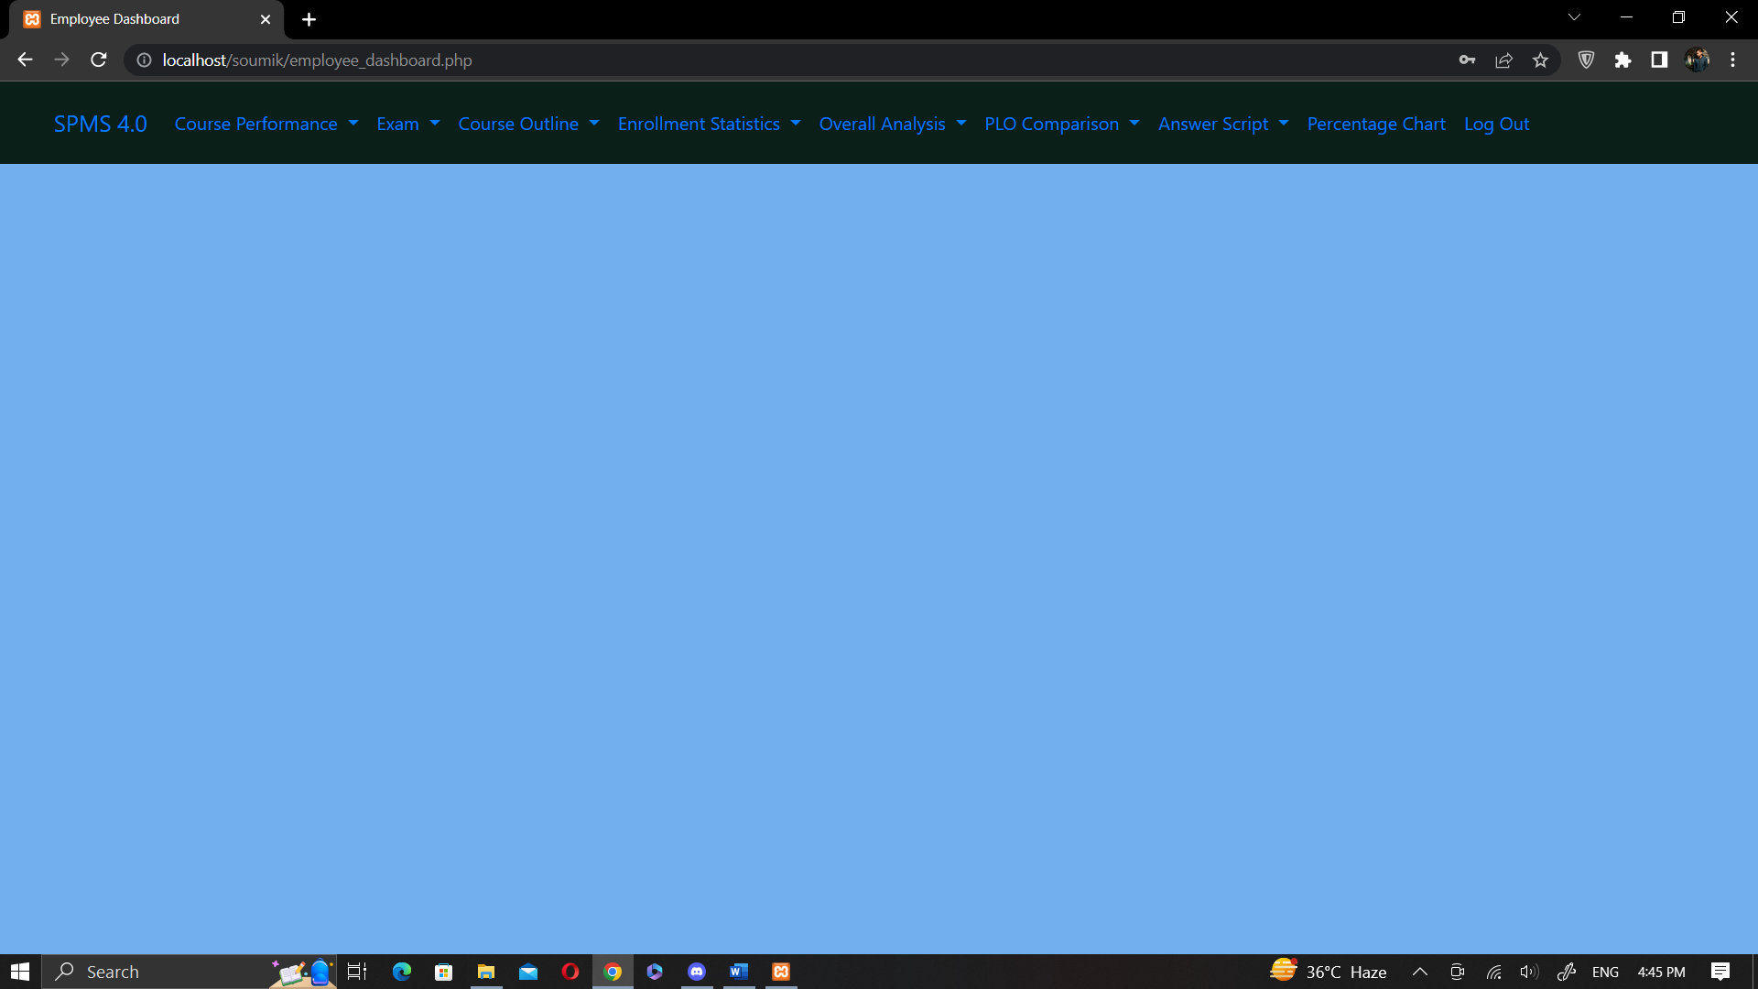
dashboard of student performance monitoring system:

Slide 6
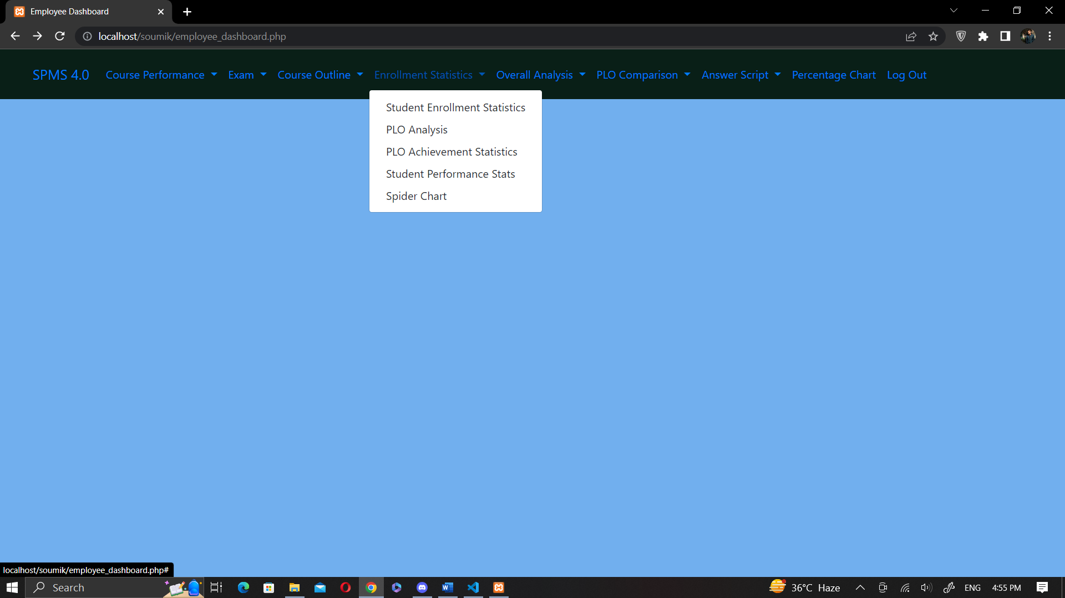
dashboard of student performance monitoring system:

Slide 7
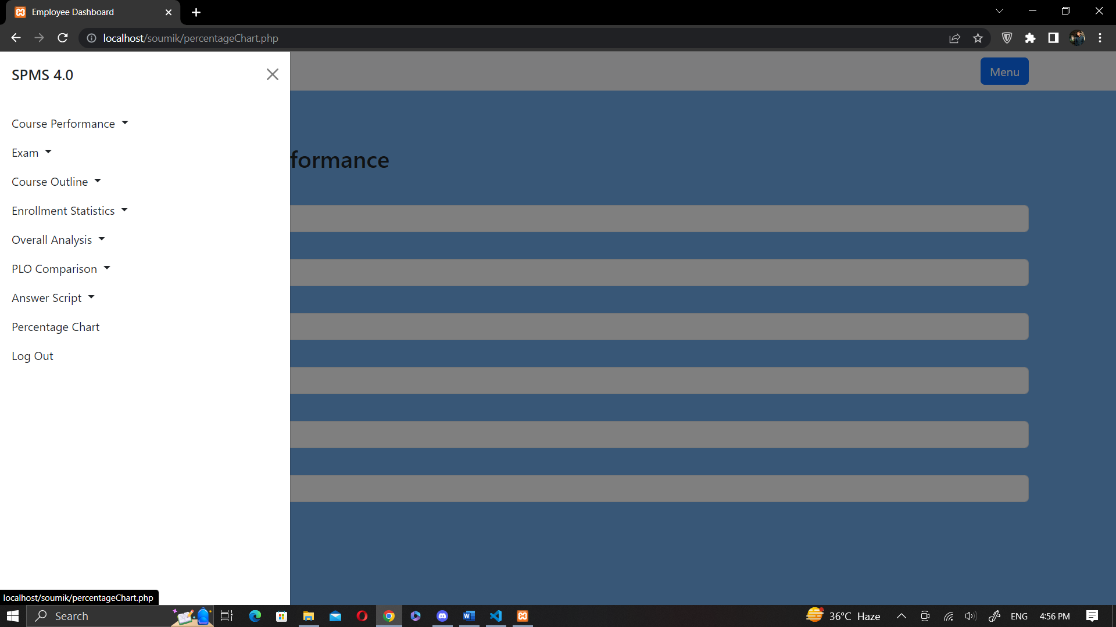
dashboard of student performance monitoring system:

Slide 8
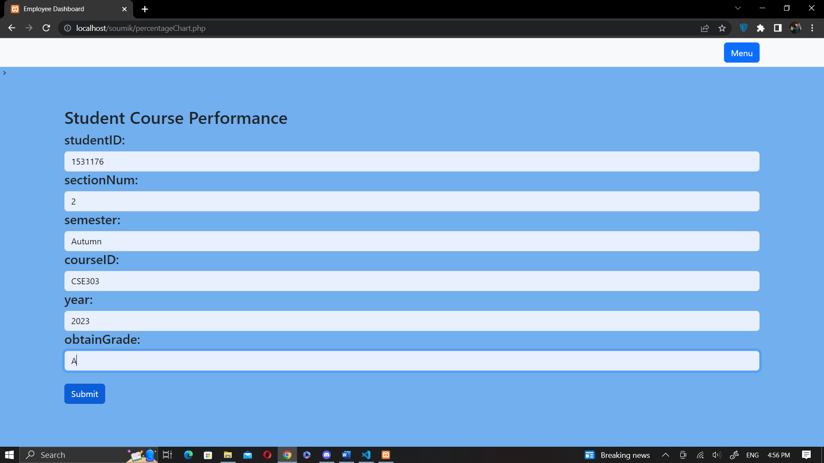
course per. page of student performance monitoring system:

Slide 9
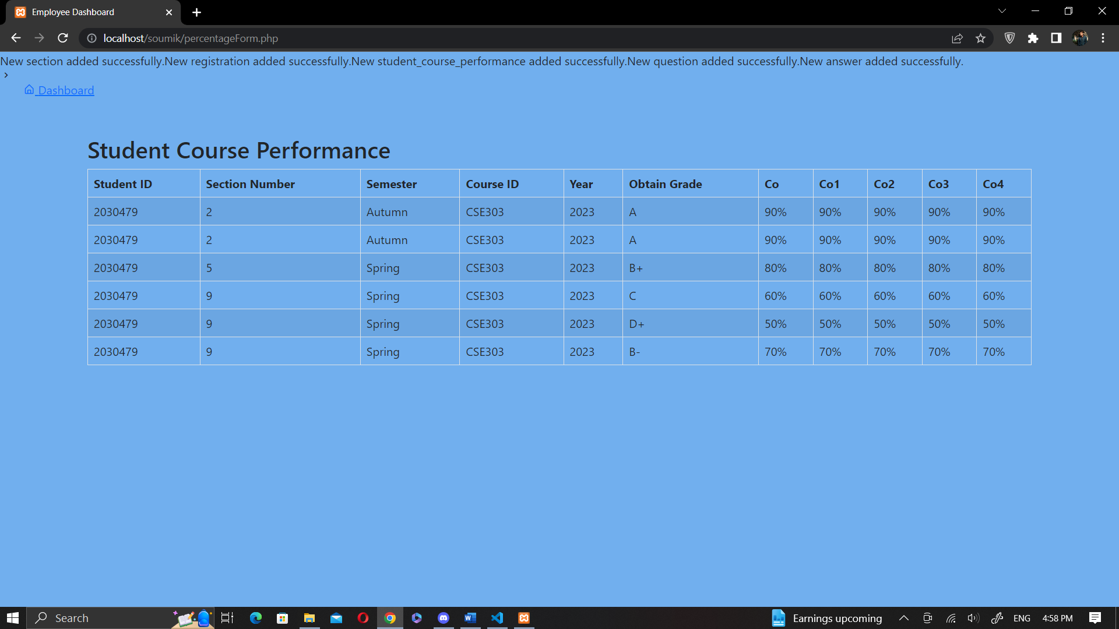
course per. result of student performance monitoring system:

Slide 10
program WE USED TO BUILD THE SYSTEM:
HTML/CSS:
HTML is used for creating the structure of a webpage, while CSS is used for styling it.
JavaScript:
A popular programming language used for adding interactivity and dynamic functionality to webpages.
PHP:
A server-side scripting language that can be used to build dynamic websites and web applications.

Slide 11
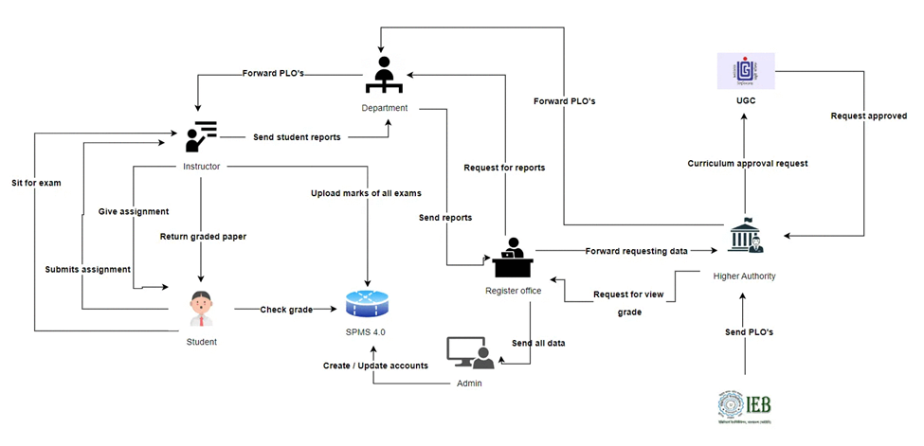
Rich-picture(as-is) for THE SYSTEM:

Slide 12
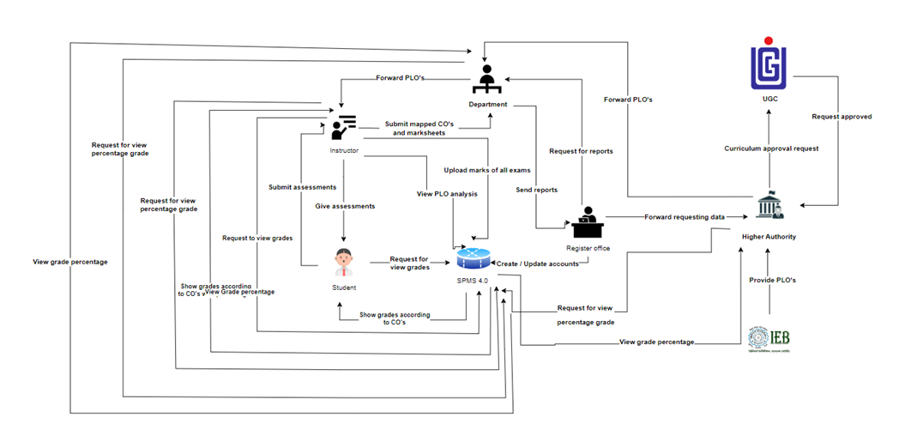
Rich-picture(to-be) for THE SYSTEM:

Slide 13
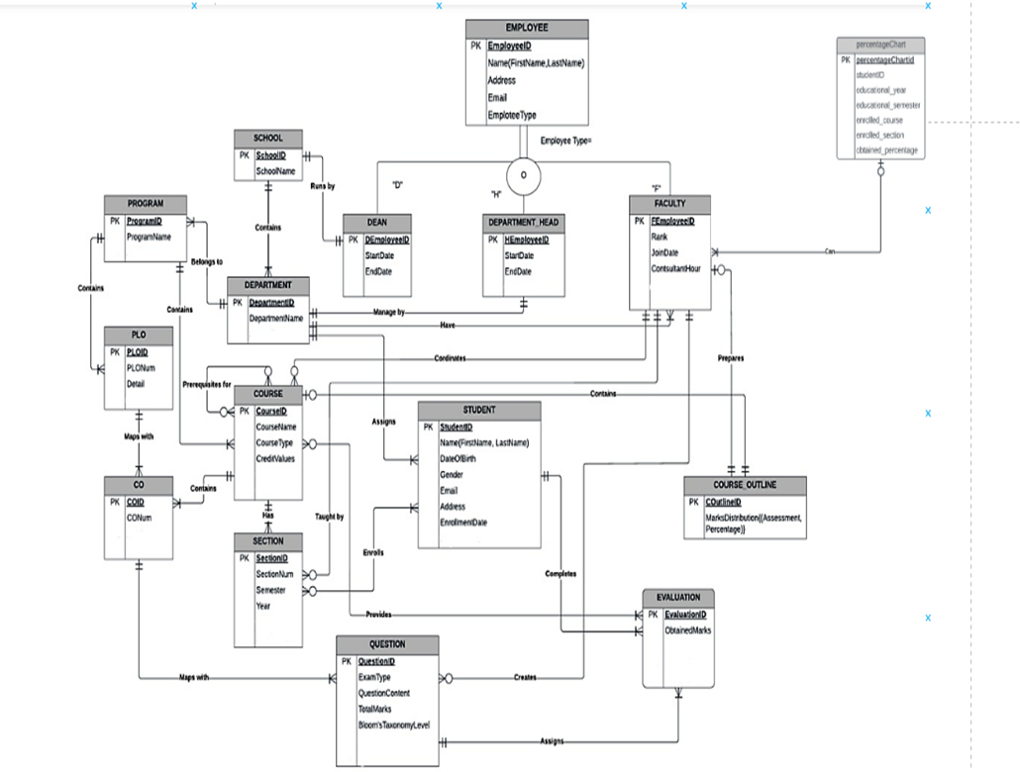
erd for THE SYSTEM:

Slide 14
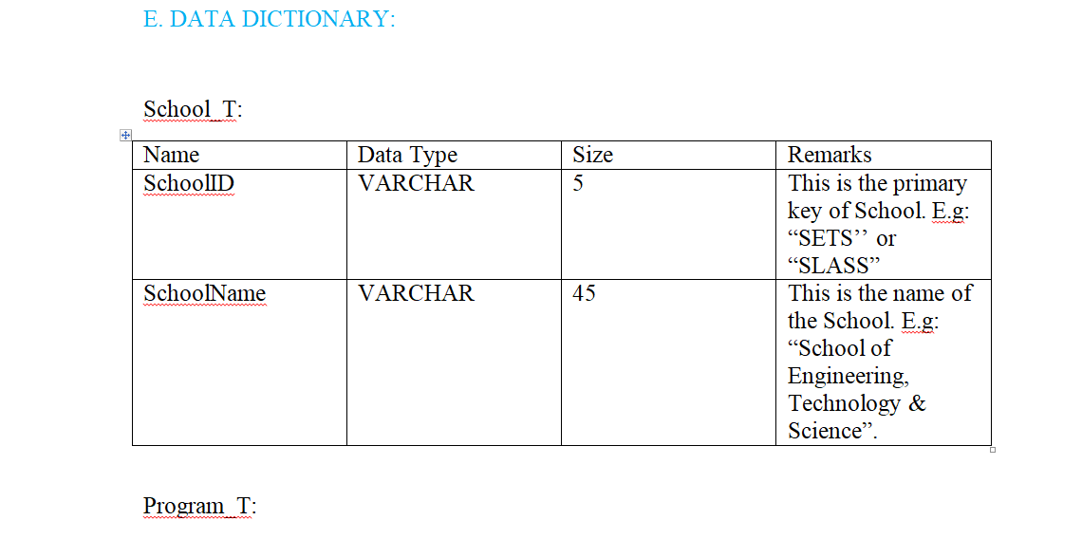
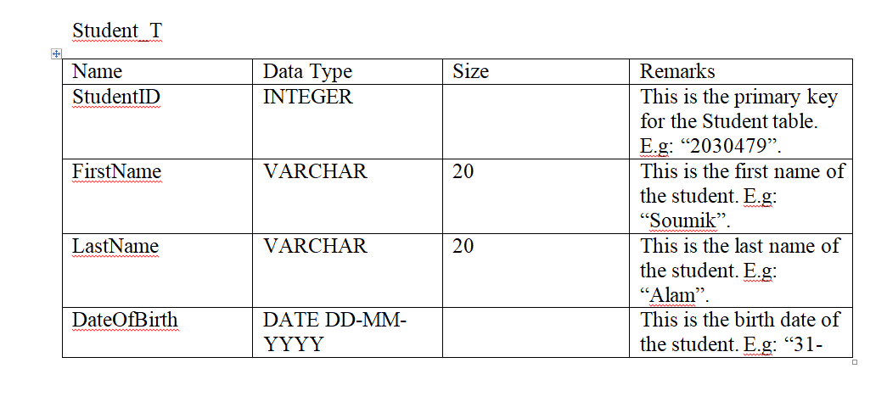
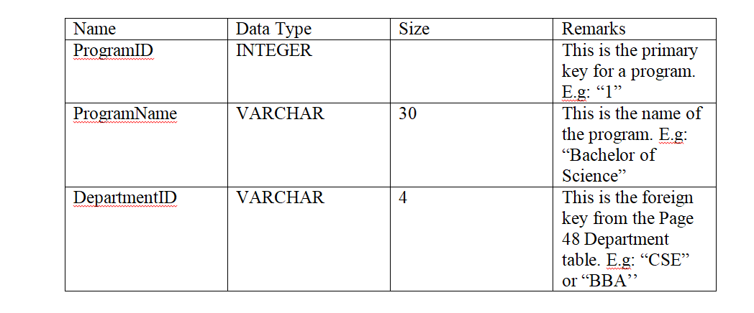
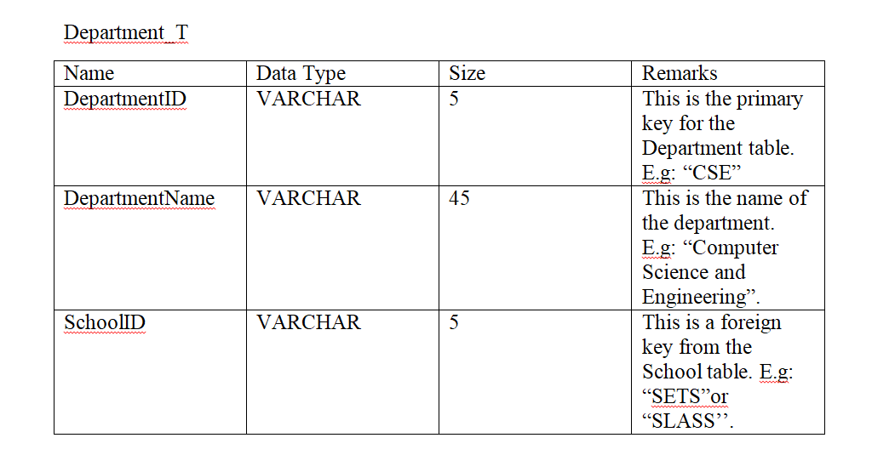
Data dictionary for THE SYSTEM:

Slide 15
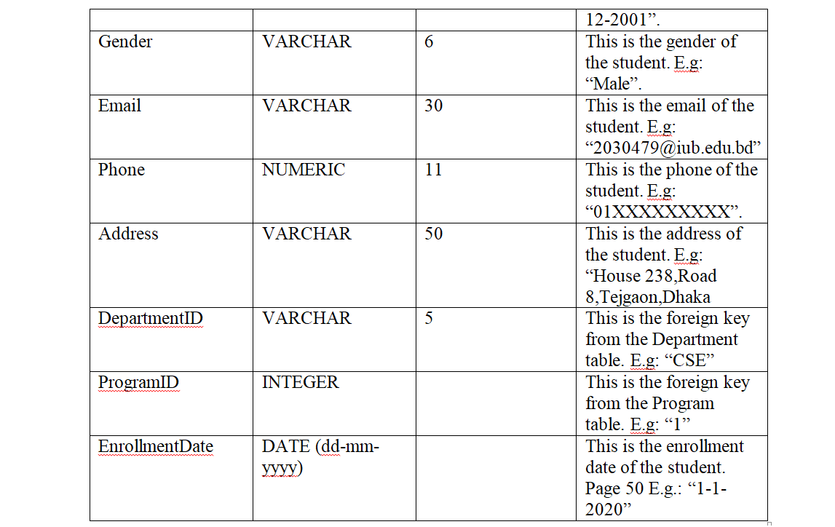
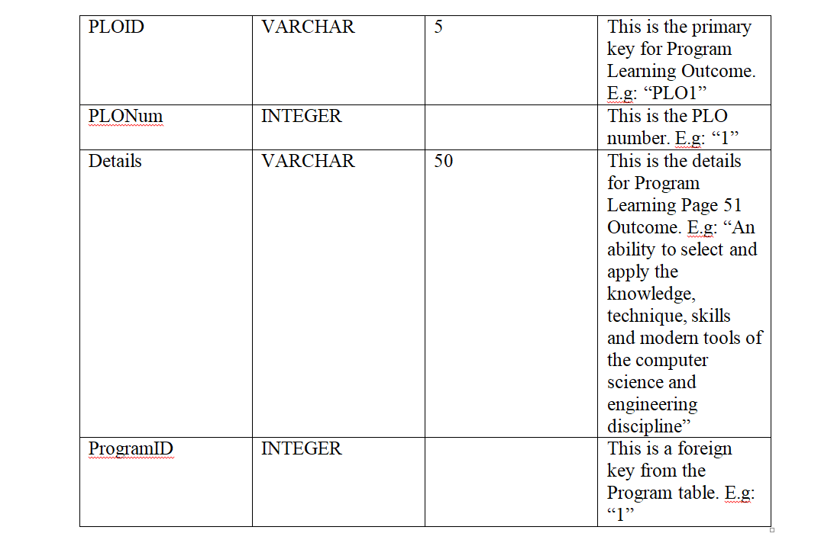
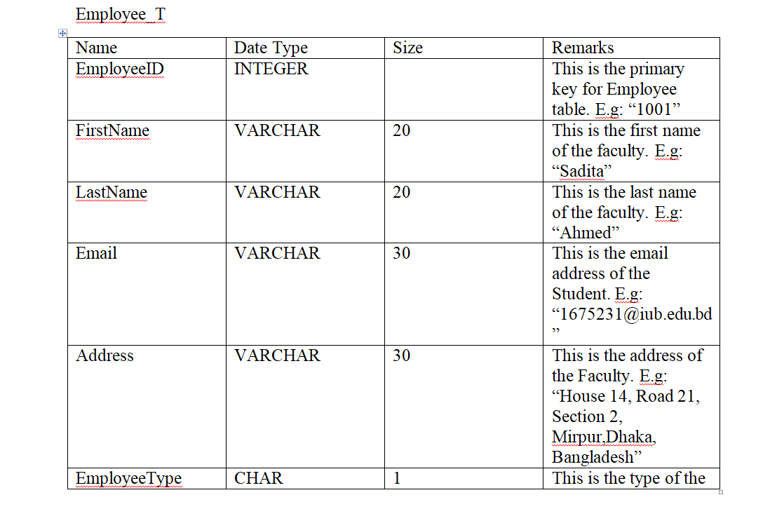
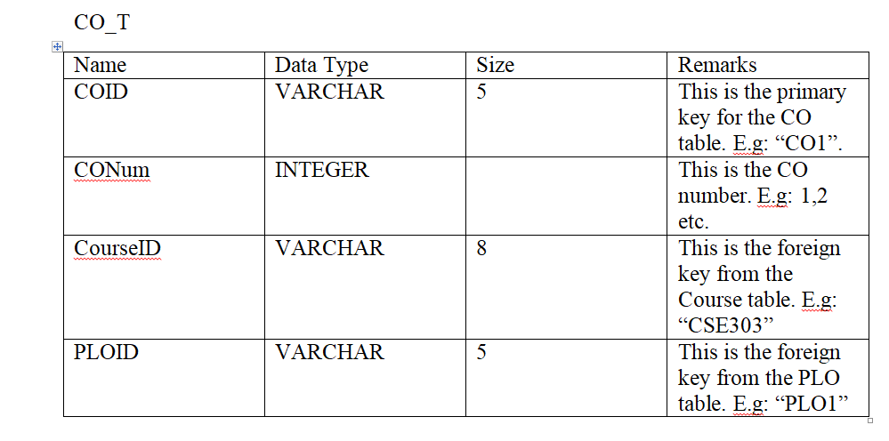
Data dictionary for THE SYSTEM:

Slide 16
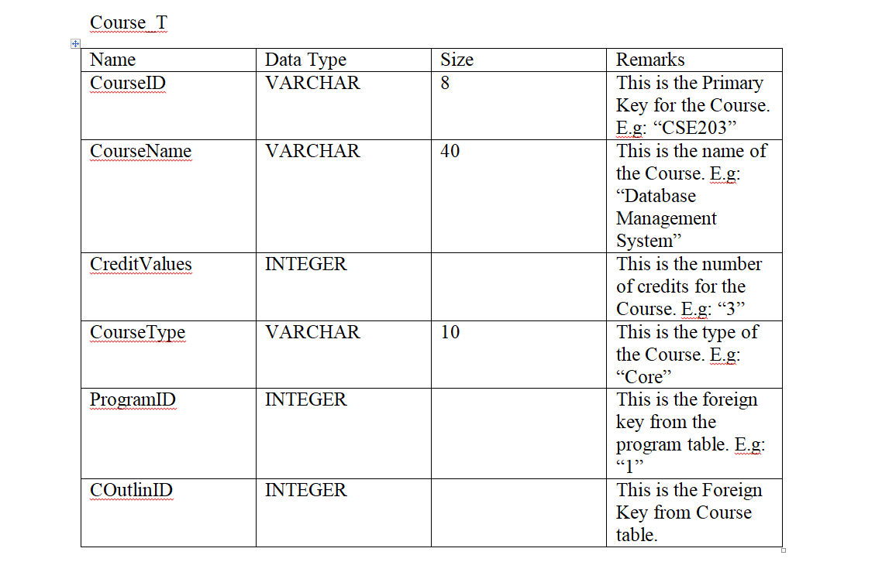
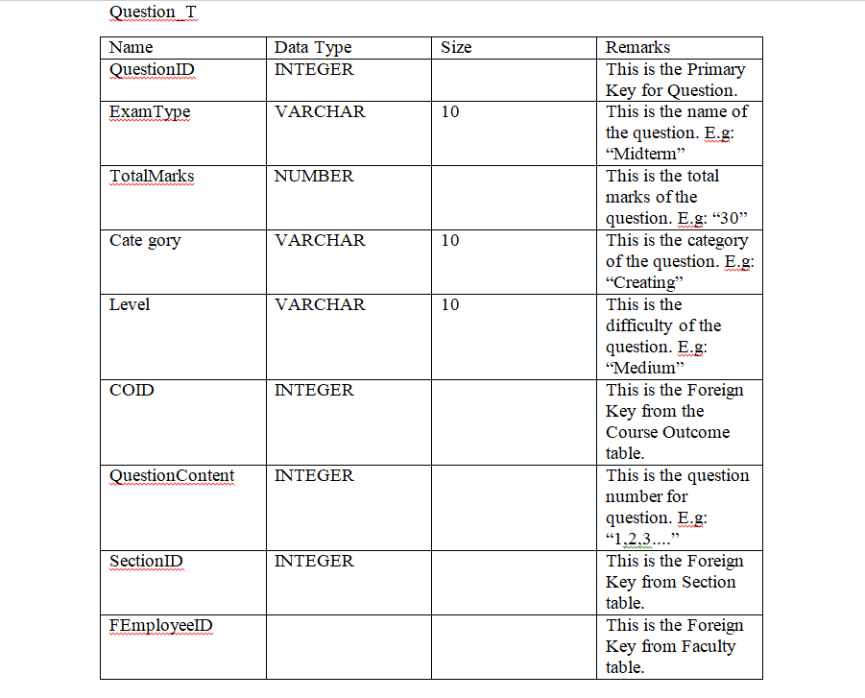
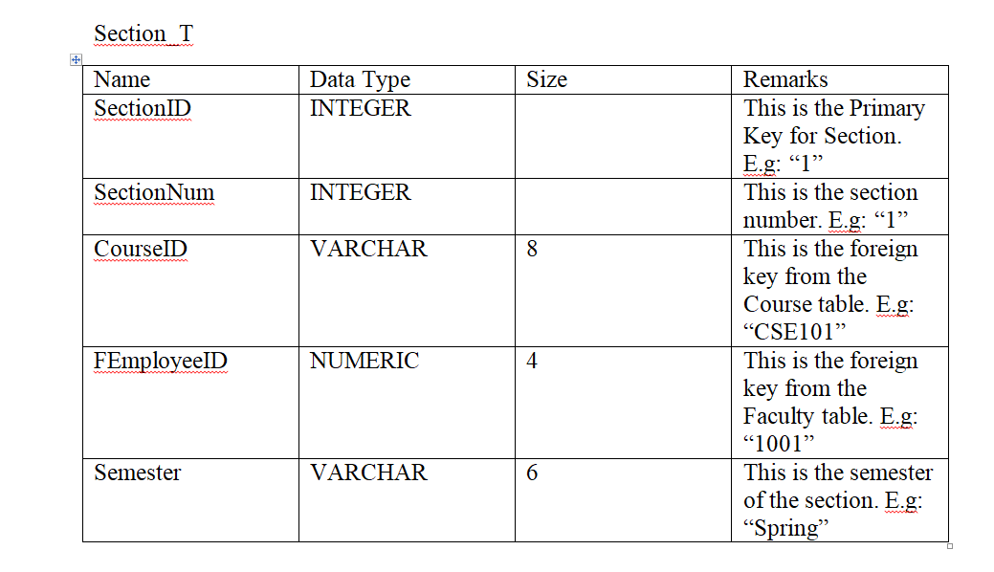
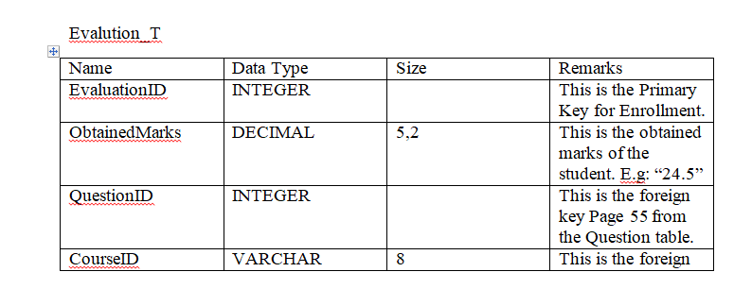
Data dictionary for THE SYSTEM:

Slide 17
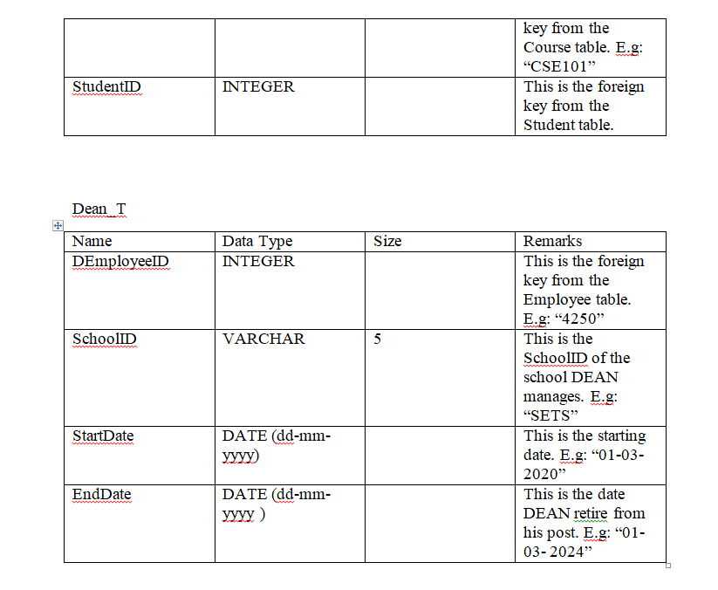
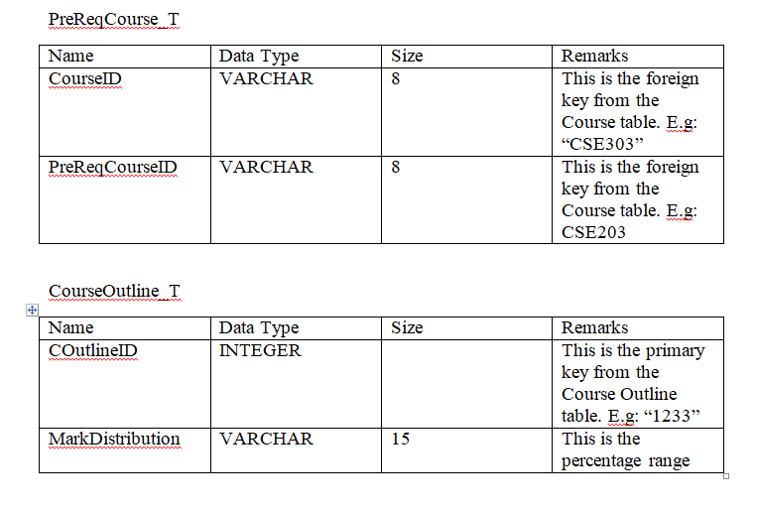
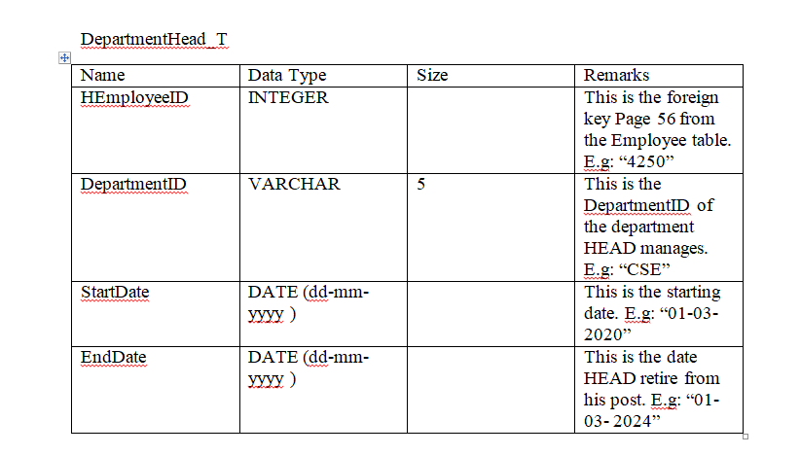
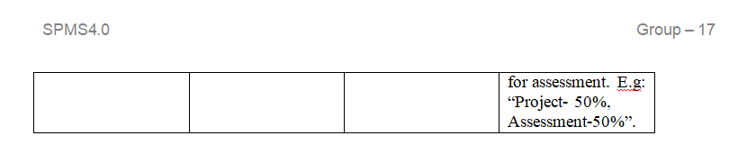
Data dictionary for THE SYSTEM:

Slide 18
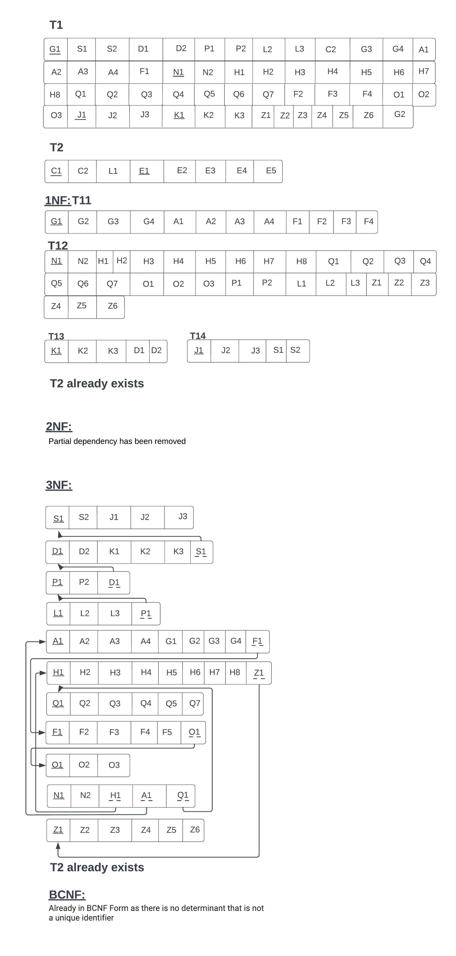
normalization for THE SYSTEM:

Slide 19
THANK YOU

